Slide 1
Using ASCOT to evaluate social care interventions The BATH-OUT Studies
12th October 2022

Slide 2
This presentation is independent research supported by the National Institute for Health and Care Research School for Social Care Research. The views expressed in this presentation are those of the authors and not necessarily those of the NHS, the National Institute for Health and Care Research or the Department of Health and Social Care

Slide 3
About Me
Currently hold a Newcastle University Academic Track (NUAcT) Fellowship
Career in social care as a homecare worker then as social care occupational therapist and occupational therapy team manager
Previous NIHR Doctoral Research Fellowship and NIHR Clinical Trials Fellowships
Research on prevention and occupational therapy in social care especially homecare and housing adaptations

Slide 4
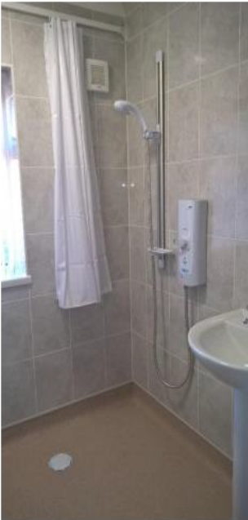
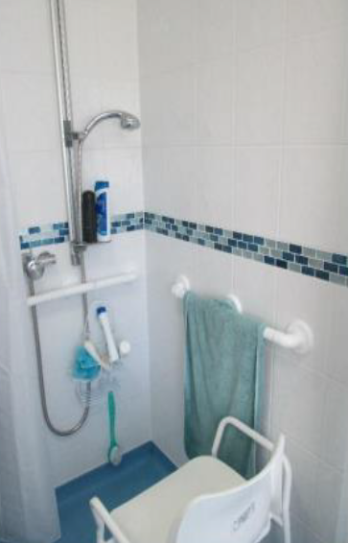

Slide 5
BATH-OUT Qualitative Study The Power of ASCOT
Whitehead, P.J. and Golding‐Day, M.R., 2019. The lived experience of bathing adaptations in the homes of older adults and their carers (BATH‐OUT): A qualitative interview study. Health & social care in the community, 27(6), pp.1534-1543.

Slide 6
Control over daily life
Social participation and involvement
Personal cleanliness and comfort
Occupation
Food and drink
Accommodation cleanliness and comfort
Personal safety
Dignity

Slide 7
Feeling Safe – “I’m not frightened like I was”
It was more—tense. Yeah, it was more like if you're going into a campaign. You're going in now, ‘eh, look out’. You're aware. You're, you've got to be careful because one slip up and you're gonna hurt yourself. It was that, like, situation which I don't have now.
Older Adult, 6

Slide 8
Feeling Clean – “I feel cleaner because I can have a really good shower”
It used to get me down because I couldn’t have a proper wash, you know what I mean? I used to wash myself down and used to still sit and you think—you just didn’t feel clean… [Now] I feel a hell of a lot better. I feel as though I’m clean. You know I’m not sniffing under my arms see if I’ve still got B.O. [body odour].
Older Adult, 18

Slide 9
Choice and Control – “I’ve got my independence back, which has took a really long time”
It's changed my life completely. From not feeling as though I'm in control, which I've been in control all my life. And for the last few years I've had no control. I have got to wait for somebody else. And I've got to sit. I can't have a shower when I want one… and [now I can] clean my whole body without any risk and nobody having to stand there and me wait for people coming.
Older Adult, 2

Slide 10
BATH-OUT-1 Feasibility Study
Whitehead, P.J., Golding-Day, M.R., Belshaw, S., Dawson, T., James, M. and Walker, M.F., 2018. Bathing adaptations in the homes of older adults (BATH-OUT): results of a feasibility randomised controlled trial (RCT). BMC Public Health, 18(1), pp.1-11.

Slide 11
About BATH-OUT-1
Is it feasible to conduct a Randomised Controlled Trial of major adaptations to bathing facilities?
Using the routine waiting list to form a control group
Suitability and sensitivity of outcome measures

Slide 12
BATH-OUT-1
Baseline Assessment
Expedited
Usual Care
3-4 month wait
Follow Ups
3, 6, 9 Months
Follow Ups
3, 6, 9 Months

Slide 13
BATH-OUT-1 Results - ASCOT
Other Outcomes
Physical Wellbeing
Mental Wellbeing
Health Related Quality of Life
Independence in Daily Living Activities
Falls
Fear of Falling

Slide 14
BATH-OUT-1 Extended Follow Up Study
Golding-Day, M. and Whitehead, P., 2020. Bathing adaptations in the homes of older adults and their carers (BATH-OUT): a qualitative extended follow-up study with concurrent nested outcome assessments. BMJ open, 10(11), p.e035701.

Slide 15
BATH-OUT-1 EFU Results - ASCOT

Slide 16
I’m not being shut in my own house. I’m getting out. I’m meeting people. I’m doing things...I have no fear of talking to anybody else now, because I know I don’t smell
Older Adult, 3

Slide 17
ASCOT Domain | Baseline Mean (SD) | Extended Follow-Up Mean (SD) | Change from baseline
Control over daily life | 2 (0.82) | 1.38 (0.77) | -0.62
Personal cleanliness and comfort | 1.84 (0.69) | 1.15 (0.55) | -0.69
Food and drink | 1.69 (0.75) | 1.08 (0.28) | -0.62
Personal safety | 1.54 (0.66) | 1 (0) | -0.54
Social participation and involvement | 1.93 (0.73) | 1.36 (0.5) | -0.57
Occupation | 2.31 (0.75) | 1.38 (0.65) | -0.92
Accommodation cleanliness and comfort | 1.46 (0.52) | 1.08 (0.28) | -0.38
Dignity | 1.92 (0.64) | 1.38 (0.65) | -0.54

Slide 18
BATH-OUT-2 Randomised Controlled Trial, Economic Evaluation and Process Evaluation

Slide 19
RCT
Economic Evaluation
Process
Evaluation
360 older adults from different geographical areas in England
Pairwise randomisation
12 month follow-up period
Cost effectiveness and cost utility analysis
Costs and resource use
Return on Investment (ROI) for expedited versus routine provision
Interview trial participants and decliners
Interview social care and housing professionals
National survey of local authorities
Physical and Mental Wellbeing
Falls
Health and Social Care Related Quality of Life
Independence in Daily Living Activities
Fear of Falling
Short Form 36
EQ5D5L
ASCOT
Barthel Index
Short Falls Efficacy Scale
Perceived difficulty in bathing scale

Slide 20
BATH-OUT-2
Sites
Yorkshire X2
Midlands
London X2

Slide 21
phillip.whitehead@newcastle.ac.uk

