Slide 1
Understanding the social care-related quality of life of people with dementia (unable to self-report) and carers in England
Stacey Rand¹, Barbora Šilarová¹, Ann-Marie Towers² & Karen Jones¹
¹ Personal Social Services Research Unit (PSSRU), University of Kent
² Centre for Health Services Research (CHSS), University of Kent

Slide 2
This presentation presents independent research funded by the NIHR under its Research for Patient Benefit (RfPB) Programme (Grant Reference: NIHR200058). The views expressed are those of the author(s) and not necessarily those of the NIHR or the Department of Health and Social Care.

Slide 3
Background
Over 767,000 people living with dementia in England and Wales
The majority (approx. two thirds) live in their own home.
Community-based social care is designed to maintain independence and QoL of people living with dementia and carers.
Dual focus of Care Act on people with support needs & their unpaid carers
However, people living with dementia are often overlooked in social care research.
E.g., Adult Social Care Survey in England (ASCS) – exclusion of people unlikely to be able to self-report from sample.

Slide 4
Aims
Measuring the outcomes of people with dementia who are unable to self-report and their carers (MOPED)
To establish the feasibility, construct validity and reliability of ASCOT-Proxy
To establish the feasibility, construct validity and reliability of ASCOT-Carer
Previously validated in a heterogeneous sample of adult carers in England (Rand et al, 2015) and identified as a suitable instrument by carers of people with dementia (Gridley et al, 2019)
To determine the factors associated with the social care-related quality of life of people with dementia (ASCOT-Proxy, proxy-reported) and their carers (ASCOT-Carer, self-reported)
Notes:
The focus here is Aim 3.

Slide 5
Methods
A survey of carers of people living with dementia in England
Online or postal questionnaire
Individual characteristics
Carer: age, gender, ethnicity, overall health
Care-recipient: age, overall health, I/ADLs, cognitive status
Caregiving situation: hours of care per week, co-residence, and self-reported financial impact of caring
Type, intensity and satisfaction with community-based care services
Outcome measures
Self-report: ASCOT-Carer, EQ-5D, C-DEMQOL, CES
Proxy-report: ASCOT-Proxy, EQ-5D-Proxy, DEMQOL-Proxy

Slide 6
ASCOT-Proxy
Personal cleanliness
and comfort
Food and drink
Personal safety
Clean and comfortable
home
Social participation
and involvement
Occupation
Doing things that I value and enjoy
Control over daily life
Dignity

Slide 7
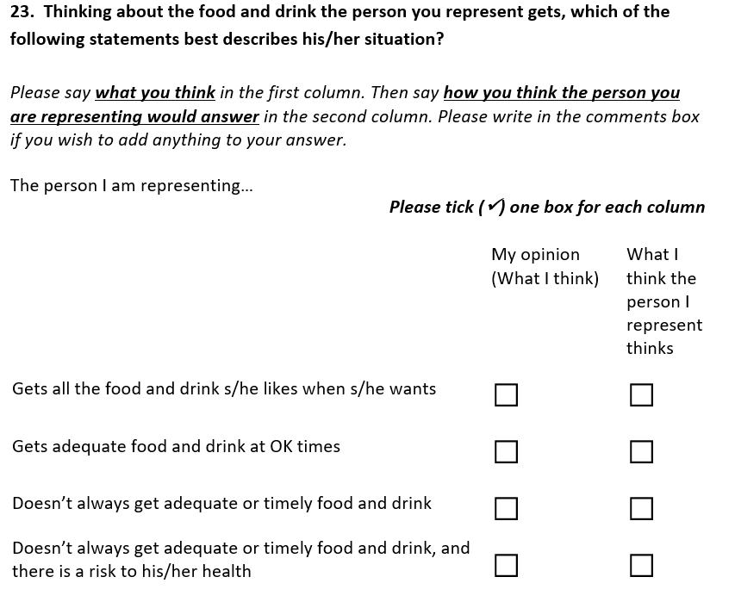
Ideal state
No needs
Some needs
High-level needs

Slide 8
ASCOT-Carer
Relationships with family and friends
Control over daily life
Occupation
(Doing things I enjoy)
Personal safety
(Feeling safe)
Feeling supported
and encouraged
Self-care
(Eating well, sleep, medical appointments)
Time and space
to be myself

Slide 9
COVID-related Policy Phases in England
1. Pre-first national lockdown
January to 25 March 2020
3. Minimal restrictions
04 July to 13 September 2020
2. First national lockdown
26 March to 03 July 2020
4. Regional tier system
14 September to 04 November 2020
5. Second national lockdown
05 November to 01 December 2020
6. Reintroducing tier system
02 to 29 December 2020
7. Third national lockdown
30 December 2020 to 07 March 2021
8. Easing restrictions
08 March 2021 to
study end (April)

Slide 10
Participants
Inclusion criteria:
A friend or family member of someone living with dementia, who:
Lives at home (not in a nursing or residential care home)
Uses at least one type of social care service
Would not be able to answer a postal or online questionnaire, even with help.
Carers:
Average age of 62.4 years
75.7% female
94.6 % white/white British
47% provided ≥50 hrs of care per week
People with dementia:
Average age of 81.5 years
48.9% were parents of carer
41.5% were partners/spouses of carer
57.8% lived in same household as carer

Slide 11
Unmet Social Care Need (% of sample, n=313)
 | ASCOT-Carer | ASCOT-Proxy proxy proxy | ASCOT-Proxy proxy person
Home cleanliness and comfort |  | 10.9% | 4.5%
Personal cleanliness and comfort |  | 14.4% | 4.5%
Food and drink |  | 15.7% | 10.2%
Dignity |  | 21.1% | 35.1%
Control over daily life | 51.8% | 55.3% | 52.7%
Occupation | 71.6% | 74.8% | 60.1%
Social participation | 58.8% | 62.9% | 49.5%
Personal safety | 3.2% | 11.8% | 16.0%
Self-care | 32.1%
Time and space | 62.6%
Feeling supported and encouraged | 50.2%
Notes:
ASCOT-Carer = Over half of sample reported unmet needs for all domains, apart from self-care and personal safety
ASCOT-Proxy (proxy proxy) = over half of sample reported unmet needs for control, occupation, social. 20% for Dignity.
The % are lower for ASCOT-Proxy (proxy person) for these three domains, but still around or over half of sample. Plus higher % dignity.

Slide 12
Results: ASCOT-Carer
 | B | 95% CI | p value
Male | .039 | -.005 to .083 | .082
Aged ≥ 65 years | .019 | -.025 to .063 | .403
Ethnicity: Black, Asian, multiple/mixed | -.072 | -.155 to .011 | .088
Self-rated health: good or very good | .124*** | .082 to .166 | <.001
MDS CPS: severe impairment | -.057** | -.094 to -.019 | .003
Co-resident with care-recipient | -.059* | -.117 to -.001 | .044
≥ 50 hrs care per week | -.069* | -.124 to -.013 | .015
Financial difficulty due to caring | -.094*** | -.132 to -.056 | <.001
Satisfied with services | .142*** | .105 to .178 | <.001
Survey completion by C-19 phase | - | - | Not Sig.
Survey online | -.021 | -.073 to .032 | .443
Constant | .651*** | .562 to .739 | <.001
* <.05, ; ** <.01 *** <.001

Slide 13
Results: ASCOT-Proxy
Proxy-Proxy rating
Suitability of home design; co-resident with carer; >50 hrs unpaid care/week; hours of home care per week; use of day services or activities (+ve)
Severe cognitive impairment; regional tier system (Sept/Nov 2020) (-ve)
Proxy-person rating
Aged 65+; I/ADLs with difficulty; severe cognitive impairment; reintroducing tier system (Dec 2020); third national lockdown (Dec 2020 to March 2021); easing restrictions (March 2021 to study end) (-ve)
Paid and unpaid care intensity or type (Not Sig.)

Slide 14
Conclusions
High % of unmet social care-related need, especially among carers
Those carers at risk of poor social care-related QoL are those with poor health, caring for ≥50 hrs/week, and experiencing financial difficulties due to caring
Satisfaction with care associated with better outcomes for carers
‘Whole family approach’
‘Think carer’
Impact of C-19 restrictions
No significant association with carers’ QoL
Significant negative association with PLWDs’ QoL
At introduction of restrictions with a tier system (proxy proxy)
At latter stages from reintroduction of tier system through to study end (proxy person)

Slide 15
Dr Stacey Rand, PSSRU, University of Kent
Email: s.e.rand@kent.ac.uk
Website: www.pssru.ac.uk/ascot

