Slide 1
Using ASCOT to inform care planning in older adult care homes
Nick Smith
CHSS, University of Kent

Slide 2
ASCOT CH4
How do you collect outcomes information in care home settings?
Mixed methods (ASCOT CH4).
Lots of data on lived experience.
Resource intensive.
Using the tool in or to inform practice
Studies: AFIS, Home-level approach.
Training and use by organisations.
Notes:
USE by organisations: some piloting of using it to inform quality monitoring in care home by LA, use in informing care planning in Cumbria more widely.
Lots of discission internally about how the tool could be developed for practitioners to use – staff using the tool in care homes,

Slide 3
Whiddon Pilot (2016-17)
Discussions with Whiddon Group (NSW) about how ASCOT can be integrated into care planning.
15-month project to pilot the approach.
61 residents across four sites.
Online training sessions lead by ASCOT team
Later training conducted by Whiddon
Notes:
Wanted
Consistent evaluation and goal settings.
Staff not confident initiating conversations about emotional and social wellbeing.
All residents needed to be included in the process.
4 training sessions – understanding ASCOT domains, Understanding current and expected SCRQoL, rating SCRQoL, understanding ASCOT data and setting goals, in the context of the ASCOT care planning approach.

Slide 4
ASCOT in Care Planning Conversations
‘Circle of Care’.
Uses the ASCOT framework to structure care planning conversations.
Uses different view points.
Can be supplemented with observation.
Rating & goal setting.

Slide 5
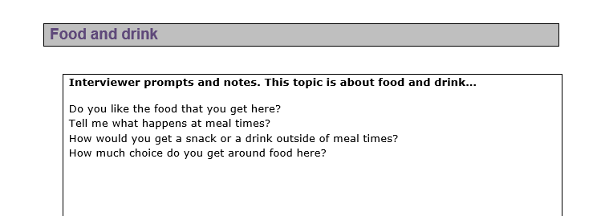
ASCOT in Care Planning Conversations

Slide 6
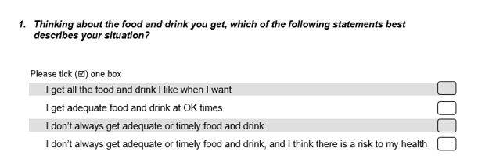
ASCOT in Care Planning Conversations

Slide 7
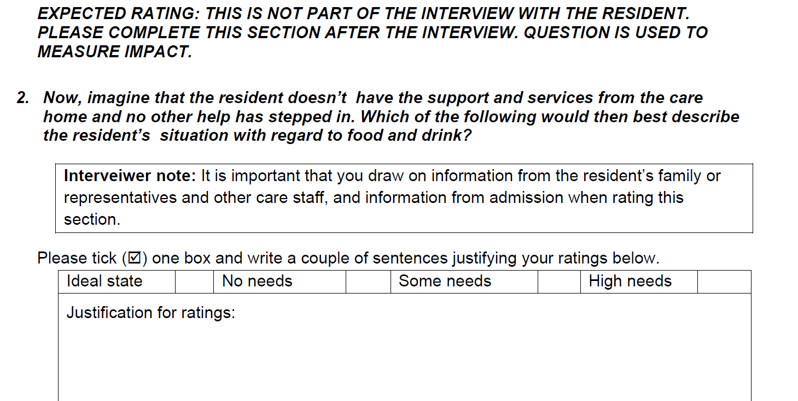
ASCOT in Care Planning Conversations

Slide 8
Whiddon experience
Initial positive response from staff, residents and family members.
Some issues with ratings.
Addressed with additional training.
Expanded to seven homes, currently five (2022).
Some homes “have made a real success of it”.
Notes:
Residents/ families liked the ASCOT domains and enjoyed conversations about aspects of their lives that would otherwise have been missed.
Staff reported better understanding of how they could support residents’ needs.

Slide 9
Whiddon experience
Challenges identified in 2022:
COVID.
Involving family.
Staff engaging with training.
Use of observation.
Overlap with required health based care planning.
Integrating into their existing system.
Notes:
Involving family – always difficult – sometime have to phone them later
Some homes tried to conduct tool without training, some don’t always engage – ratings – staff tend to find the tool valuable when they do it properly.

Slide 10
UK pilot
UK older adult care home provider (2021)
Trained staff to deliver ASCOT in care planning in four homes.
Plan to trial and evaluate use over 18 months.
Worked cancelled due to COVID-19 and issues around staff capacity.

Slide 11
Attendo pilot (2021-)
Sharing of approach in three online sessions

Slide 12
Thank you for listening
n.j.smith@kent.ac.uk
@Nick_Os_Smith

