Slide 1
Research (Funding) Support at Kent
Dr Sarah Tetley
Research Development Officer (Social Sciences)
21/1/20

Slide 2
Cradle to Grave
Development
Identify funders
Help with the proposal and application process
Costing
Sarah Tetley
Institutional ‘sign off’
‘Accept’ award and negotiate contract
Manage Award
Contracts
Jo Verral
Financial claims
End of Award reports
Accounts
Nigel Martin / Lynnette Maling
Ethics and Governance
Research Excellence
https://research.kent.ac.uk/researchservices/contact/
Notes:
Research Excellence team supports and monitors the REF, ORCID, Public Engagement and Research Impact, as well as the systems supporting Research Management, such as KRIMSON, SciVal and Vertigo Ventures.

Slide 3
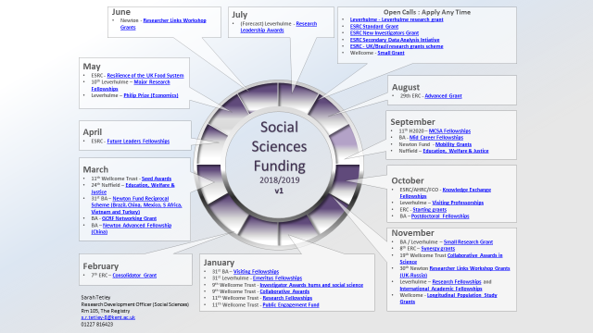
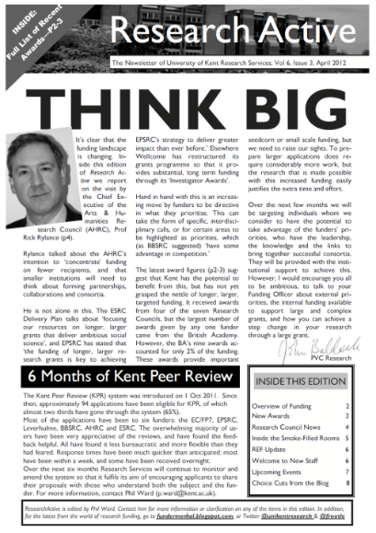
Help in Developing Applications
Information
Funding opportunities - search here
Background news & insights
Training
Grants Factory
ECR Network
Facilitating collaboration
Sandpits
Briefing events
Making applications
Copy editing, proof reading and advice on the text
Successful proposals bank
Peer Review
Costings & Institutional Approval
Research governance
Notes:
RP password is Fredster211210

Slide 4
Getting started : the basics
Got an idea? Talk to someone about it….
Identify your funder(s) – RESEARCH PROFESSIONAL
Read for the funder guidelines
Complete a new costing and approval spreadsheet and send it to Jo
Get writing & share widely .. Grant vs Journal writing
Give yourself & others enough time (manage the deadline) – see HERE
Submit…but be prepared for rejection (have a Plan B, C and D in place)

Slide 5
Further Information
Contact details:
Sarah Tetley s.r.tetley-8@kent.ac.uk 01227 816423
Jo Verrall J.Verrall@kent.ac.uk 01227 824624
Lynnette Maling L.K.Maling@kent.ac.uk 01227 823882
Research Services http://www.kent.ac.uk/researchservices/index.html
Internal Approval Process
https://research.kent.ac.uk/researchservices/costing-and-approval/
Jacqueline Aldridge & Andrew Derrington: The Research Funding Toolkit (Sage, 2012) (http://www.researchfundingtoolkit.org/)

